Slide 1
Linear Relationships
Summary /revision lesson
James Wilson

Slide 2

Linear relationships – What have we learned
Linear Relationships form straight lines when graphed
They have equations in the form of $y=mx+c$ where m is the gradient and c is the y intercept
We use tables, equations and graphs to show linear relationships.

Slide 3
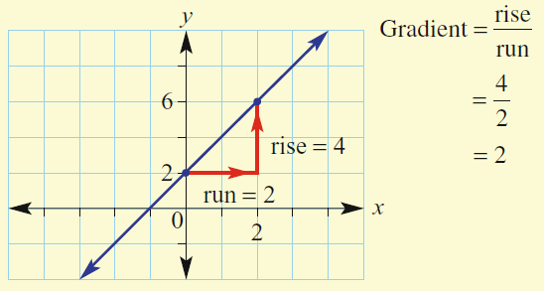
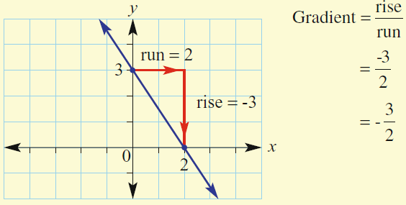
So lets practice a few things…
The gradient of a line is how steep it is.
Going up gives a positive gradient
Going down gives a negative gradient

Slide 4
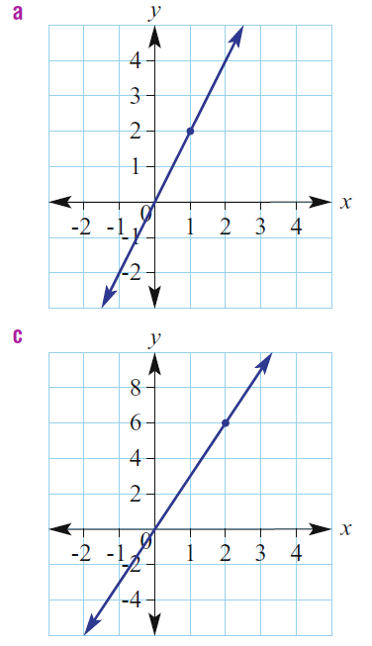
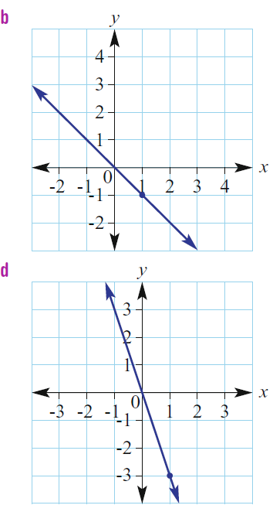
Use rise ÷ run to find the gradient for each of the following
Rise =
Run =
rise ÷ run =
Rise =
Run =
rise ÷ run =
Practice time
Rise =
Run =
rise ÷ run =
Rise =
Run =
rise ÷ run =

Slide 5
Use rise ÷ run to find the gradient for each of the following
Rise = 2
Run = 1
rise ÷ run = 2
Rise = -1 (because it goes down)
Run = 1
rise ÷ run = -1
Answers
Rise = 3
Run = 2
rise ÷ run = 1.5
Rise = -3
Run = 1
rise ÷ run = -3

Slide 6
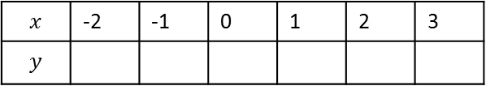




Graphs, tables and rules are connected
$$x$$ | -2 | -1 | 0 | 1 | 2 | 3
$$y$$
-3
We can use a rule to fill the table
$$y=2x+1$$
$$y=2(−2)+1$$
$$y=−4+1$$
$$y=−3$$

Slide 7
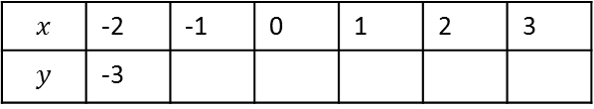



Graphs, tables and rules are connected
$$x$$ | -2 | -1 | 0 | 1 | 2 | 3
$$y$$ | -3
-1
We can use a rule to fill the table
$$y=2x+1$$
$$y=2(−1)+1$$
$$y=−2+1$$
$y=−$1

Slide 8
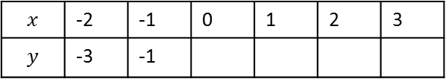



Graphs, tables and rules are connected
$$x$$ | -2 | -1 | 0 | 1 | 2 | 3
$$y$$ | -3 | -1
1
We can use a rule to fill the table
$$y=2x+1$$
$$y=2(0)+1$$
$$y=0 +1$$
$y=$1

Slide 9
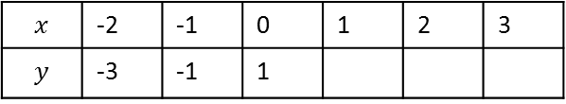



Graphs, tables and rules are connected
$$x$$ | -2 | -1 | 0 | 1 | 2 | 3
$$y$$ | -3 | -1 | 1
3
We can use a rule to fill the table
$$y=2x+1$$
$$y=2(1)+1$$
$$y=2 +1$$
$y=$3

Slide 10
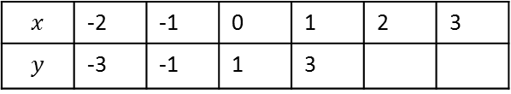



Graphs, tables and rules are connected
$$x$$ | -2 | -1 | 0 | 1 | 2 | 3
$$y$$ | -3 | -1 | 1 | 3
5
We can use a rule to fill the table
$$y=2x+1$$
$$y=2(2)+1$$
$$y=4 +1$$
$$y= 5$$

Slide 11
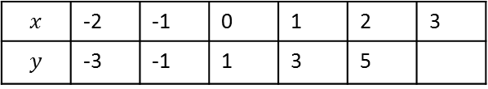



Graphs, tables and rules are connected
$$x$$ | -2 | -1 | 0 | 1 | 2 | 3
$$y$$ | -3 | -1 | 1 | 3 | 5
7
We can use a rule to fill the table
$$y=2x+1$$
$$y=2(3)+1$$
$$y=6 +1$$
$y=$7

Slide 12

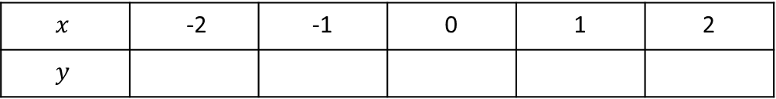
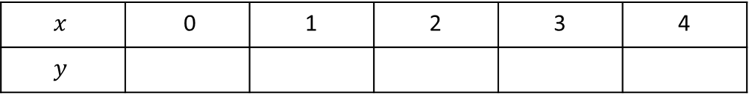

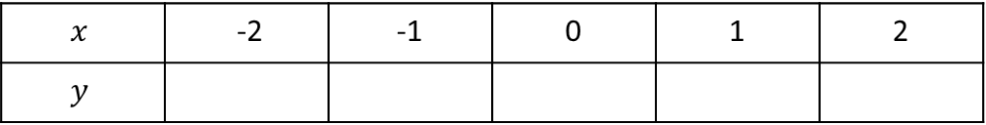

So lets practice …
Fill in the tables from using the rules given.
$$y=x−2$$
$$x$$ | 0 | 1 | 2 | 3 | 4
$$y$$
Practice time
$$y=4x+1$$
$$x$$ | -2 | -1 | 0 | 1 | 2
$$y$$
$$y=−x+3$$
$$x$$ | -2 | -1 | 0 | 1 | 2
$$y$$

Slide 13
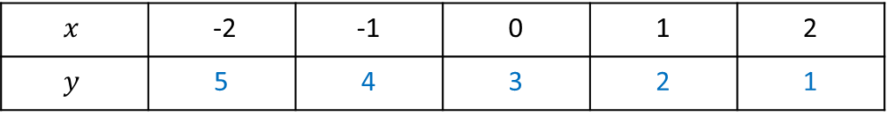
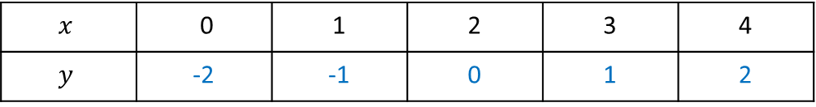
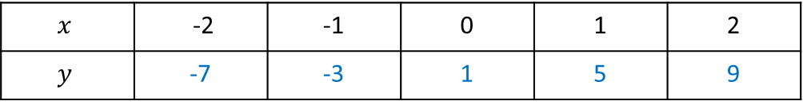
So lets practice …
Fill in the tables from using the rules given.
$$y=x−2$$
$$x$$ | 0 | 1 | 2 | 3 | 4
$$y$$ | -2 | -1 | 0 | 1 | 2
Answers
$$y=4x+1$$
$$x$$ | -2 | -1 | 0 | 1 | 2
$$y$$ | -7 | -3 | 1 | 5 | 9
$$y=−x+3$$
$$x$$ | -2 | -1 | 0 | 1 | 2
$$y$$ | 5 | 4 | 3 | 2 | 1

Slide 14
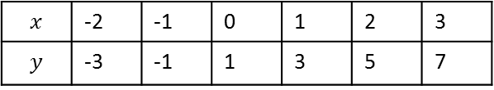




We can also get the equation from the table
Graphs, tables and rules are connected
1
1
1
1
1
$$x$$ | -2 | -1 | 0 | 1 | 2 | 3
$$y$$ | -3 | -1 | 1 | 3 | 5 | 7
Each time $x$ is increased by 1
$y$ is increased by 2
2
2
2
2
2
This “difference pattern” is the Gradient or m
$$y=mx+c$$
$$y=2x+c$$

Slide 15



We can also get the equation from the table
Graphs, tables and rules are connected
$$x$$ | -2 | -1 | 0 | 1 | 2 | 3
$$y$$ | -3 | -1 | 1 | 3 | 5 | 7
When $x$ = 0
The $y$ value gives us the “$y$ intercept” or “c”
$$y=mx+c$$
$$y=2x+c$$
$$y=2x+1$$

Slide 16
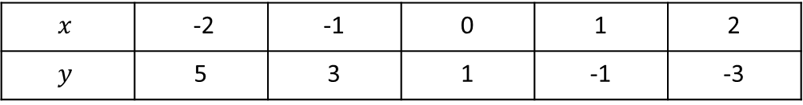
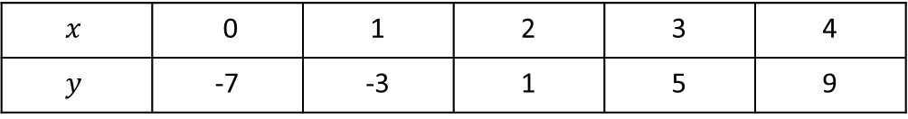


Find the equations that were used to make these tables.
$$x$$ | 0 | 1 | 2 | 3 | 4
$$y$$ | -7 | -3 | 1 | 5 | 9
m (also called gradient or Difference pattern ) =
c (also called y intercept (at x = 0)) =
Therefore
Practice time
$y=____x+$____
$$x$$ | -2 | -1 | 0 | 1 | 2
$$y$$ | 5 | 3 | 1 | -1 | -3
m (also called gradient or Difference pattern ) =
c (also called y intercept (at x = 0)) =
Therefore
$y=____x+$____

Slide 17

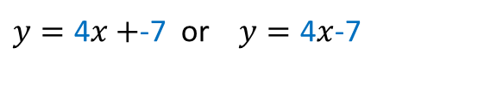
Find the equations that were used to make these tables.
$$x$$ | 0 | 1 | 2 | 3 | 4
$$y$$ | -7 | -3 | 1 | 5 | 9
m (also called gradient or Difference pattern ) = 4
c (also called y intercept (at x = 0)) = -7
Therefore
$y=\text{4}x+$-7 or $y=\text{4}x$-7
$$x$$ | -2 | -1 | 0 | 1 | 2
$$y$$ | 5 | 3 | 1 | -1 | -3
m (also called gradient or Difference pattern ) = 2
c (also called y intercept (at x = 0)) = 1
Therefore
$y=\text{2}x+$ 1

Slide 18
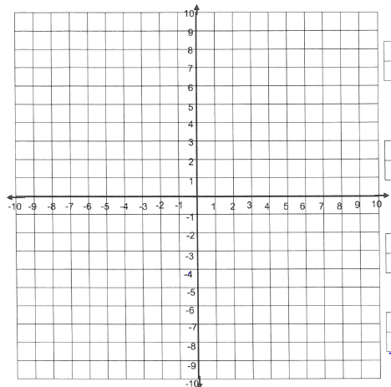
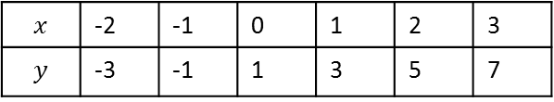




$$y$$
Graphs, tables and rules are connected
From a table we can plot the points
$$y=2x+1$$
X
$$x$$ | -2 | -1 | 0 | 1 | 2 | 3
$$y$$ | -3 | -1 | 1 | 3 | 5 | 7
X
(-2,-3) (-1,-1) (0,1) (1,3) (2,5) (3,7)
X
X
$$x$$
X
$$y=2x+1$$
X

Slide 19

$$y$$
Graphs, tables and rules are connected
From a table we can plot the points
$$y=2x+1$$
X
$$x$$ | -2 | -1 | 0 | 1 | 2 | 3
$$y$$ | -3 | -1 | 1 | 3 | 5 | 7
X
(-2,-3) (-1,-1) (0,1) (1,3) (2,5) (3,7)
X
We can also draw the line directly from the equation
X
$$x$$
X
$$y=2x+1$$
By using the y intercept
X

Slide 20
$$y$$
Graphs, tables and rules are connected
From a table we can plot the points
$$y=2x+1$$
X
$$x$$ | -2 | -1 | 0 | 1 | 2 | 3
$$y$$ | -3 | -1 | 1 | 3 | 5 | 7
X
(-2,-3) (-1,-1) (0,1) (1,3) (2,5) (3,7)
X
we go up by
2
We can also draw the line directly from the equation
X
Each time we go across by 1
$$x$$
X
$$y=2x+1$$
By using the y intercept
X
and the gradient

Slide 21
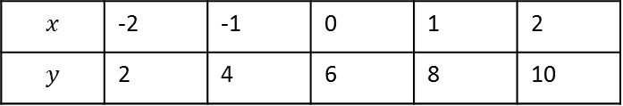

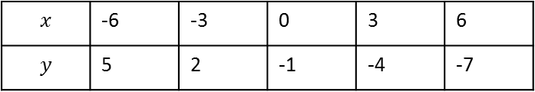

Draw the graphs from the following tables and equations
1.
2.
3.
4.
$$x$$ | -2 | -1 | 0 | 1 | 2
$$y$$ | 2 | 4 | 6 | 8 | 10
$$y=3x−1$$
Practice time
$$x$$ | -6 | -3 | 0 | 3 | 6
$$y$$ | 5 | 2 | -1 | -4 | -7
$$y=0.5x+3$$

Slide 22
1.
Draw the graphs from the following tables and equations
1.
2.
3.
4.
$$x$$ | -2 | -1 | 0 | 1 | 2
$$y$$ | 2 | 4 | 6 | 8 | 10
2.
4.
$$y=3x−1$$
Answers
$$x$$ | -6 | -3 | 0 | 3 | 6
$$y$$ | 5 | 2 | -1 | -4 | -7
$$y=0.5x+3$$
3.

Slide 23
$$y$$
Graphs, tables and rules are connected
$$y=2x+1$$
X
$$x$$ | -2 | -1 | 0 | 1 | 2 | 3
$$y$$ | -3 | -1 | 1 | 3 | 5 | 7
We can also get the points from the graph to make a table
X
(-2,-3) (-1,-1) (0,1) (1,3) (2,5) (3,7)
X
X
$$x$$
X
$$y=2x+1$$
X

Slide 24
$$y$$
Graphs, tables and rules are connected
$$y=2x+1$$
X
$$x$$ | -2 | -1 | 0 | 1 | 2 | 3
$$y$$ | -3 | -1 | 1 | 3 | 5 | 7
We can also get the points from the graph to make a table
X
(-2,-3) (-1,-1) (0,1) (1,3) (2,5) (3,7)
X
X
$$x$$
X
$$y=2x+1$$
X

Slide 25
$$y$$
Graphs, tables and rules are connected
$$y=2x+1$$
X
$$x$$ | -2 | -1 | 0 | 1 | 2 | 3
$$y$$ | -3 | -1 | 1 | 3 | 5 | 7
We can also get the points from the graph to make a table
X
(-2,-3) (-1,-1) (0,1) (1,3) (2,5) (3,7)
X
X
$$x$$
X
$$y=2x+1$$
X

Slide 26
$$y$$
Graphs, tables and rules are connected
$$y=2x+1$$
X
$$x$$ | -2 | -1 | 0 | 1 | 2 | 3
$$y$$ | -3 | -1 | 1 | 3 | 5 | 7
We can also get the points from the graph to make a table
X
(-2,-3) (-1,-1) (0,1) (1,3) (2,5) (3,7)
X
X
$$x$$
X
$$y=2x+1$$
X

Slide 27
$$y$$
Graphs, tables and rules are connected
$$y=2x+1$$
X
$$x$$ | -2 | -1 | 0 | 1 | 2 | 3
$$y$$ | -3 | -1 | 1 | 3 | 5 | 7
We can also get the points from the graph to make a table
X
(-2,-3) (-1,-1) (0,1) (1,3) (2,5) (3,7)
X
X
$$x$$
X
$$y=2x+1$$
X

Slide 28
$$y$$
Graphs, tables and rules are connected
$$y=2x+1$$
X
$$x$$ | -2 | -1 | 0 | 1 | 2 | 3
$$y$$ | -3 | -1 | 1 | 3 | 5 | 7
We can also get the points from the graph to make a table
X
(-2,-3) (-1,-1) (0,1) (1,3) (2,5) (3,7)
X
X
$$x$$
X
$$y=2x+1$$
X

Slide 29
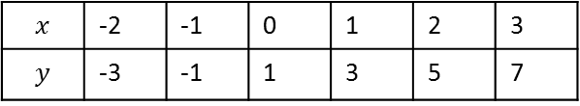

$$y$$
Graphs, tables and rules are connected
$$x$$ | -2 | -1 | 0 | 1 | 2 | 3
$$y$$ | -3 | -1 | 1 | 3 | 5 | 7
$$y=2x+1$$
X
(-2,-3) (-1,-1) (0,1) (1,3) (2,5) (3,7)
X
X
Rise = 4
Or we can get the equation directly from the graph
X
Run = 2
Gradient = Rise ÷ run = 4 ÷ 2
= 2
$$x$$
X
$$y=2x+1$$
X
Crosses y line at 1
By using the y intercept
and the gradient

Slide 30
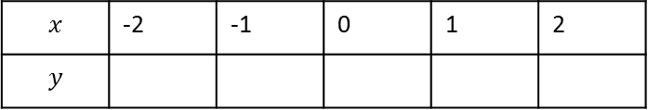

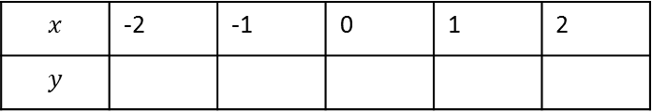

1.
From the graph, fill in the tables or work out the equation
1.
2.
3.
4.
4.
2.
$$x$$ | -2 | -1 | 0 | 1 | 2
$$y$$
Practice time
$y=____x$+____
$$x$$ | -2 | -1 | 0 | 1 | 2
$$y$$
3.
$y=____x$+____

Slide 31
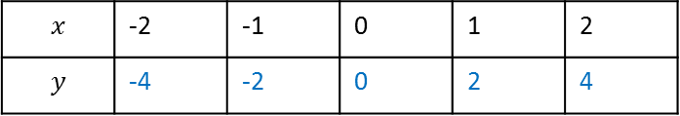

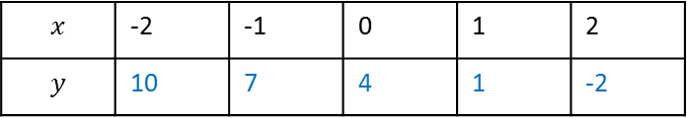

1.
From the graph, fill in the tables or work out the equation
1.
2.
3.
4.
4.
2.
$$x$$ | -2 | -1 | 0 | 1 | 2
$$y$$ | -4 | -2 | 0 | 2 | 4
Answers
$$y=x+2$$
$$x$$ | -2 | -1 | 0 | 1 | 2
$$y$$ | 10 | 7 | 4 | 1 | -2
3.
$y=2x$+2

Slide 32
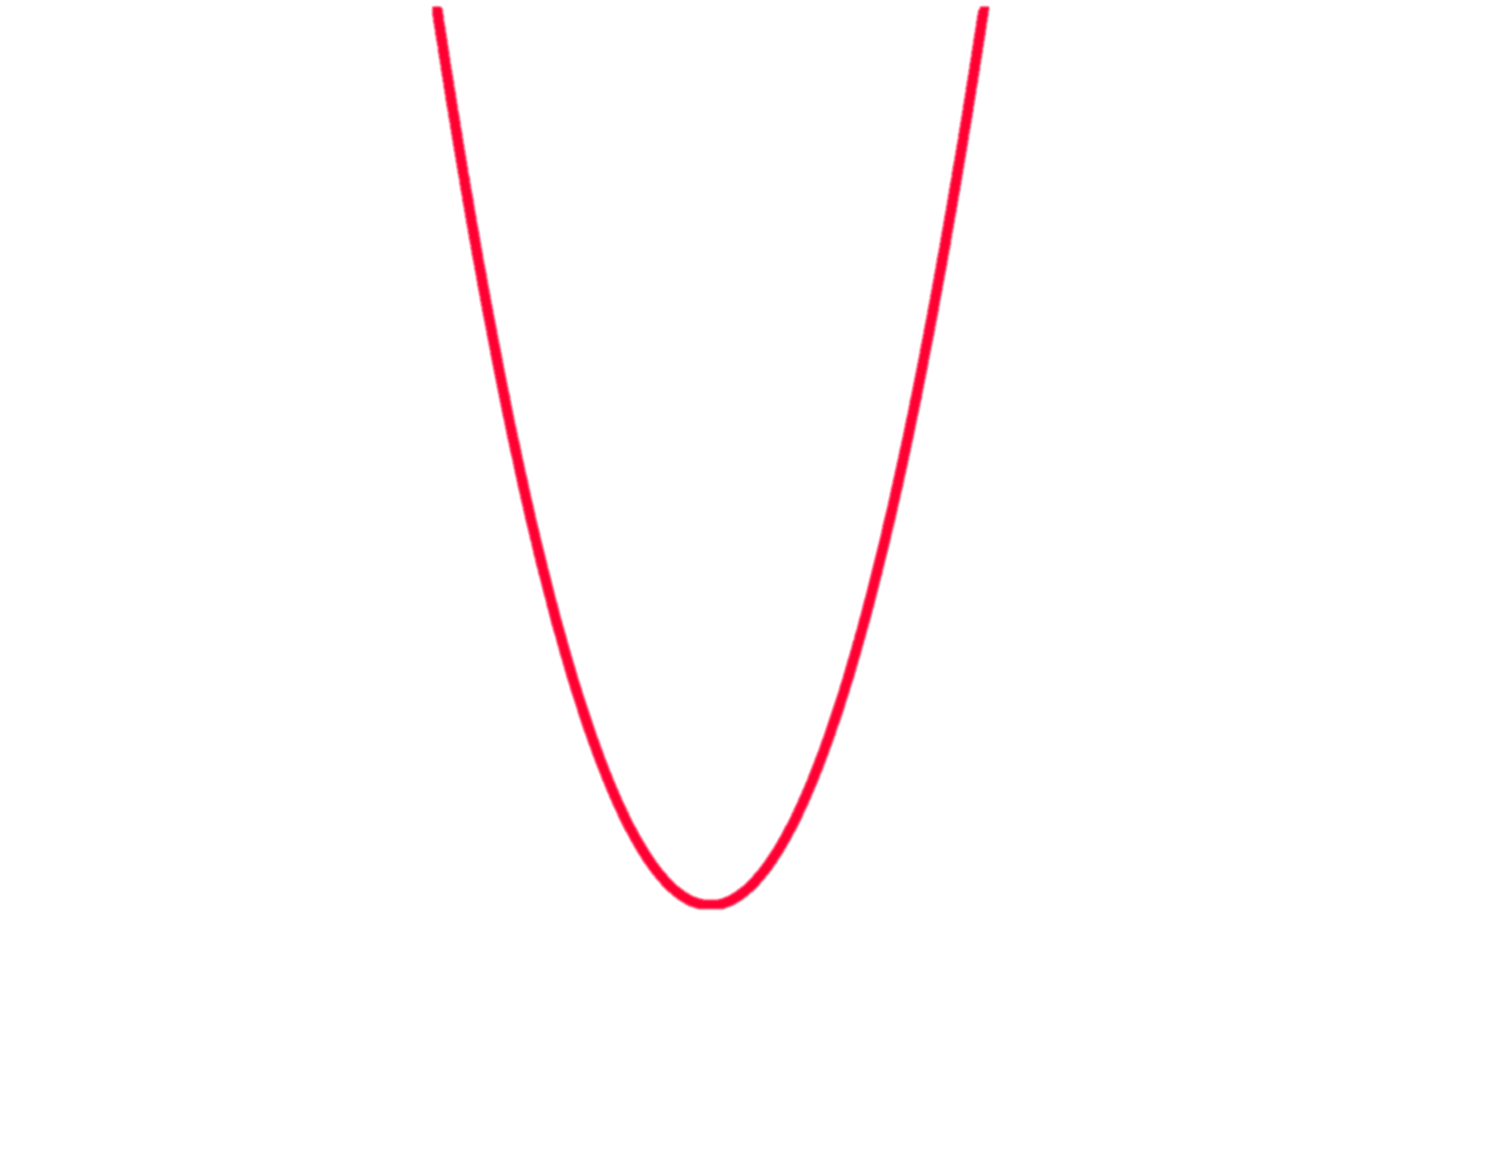
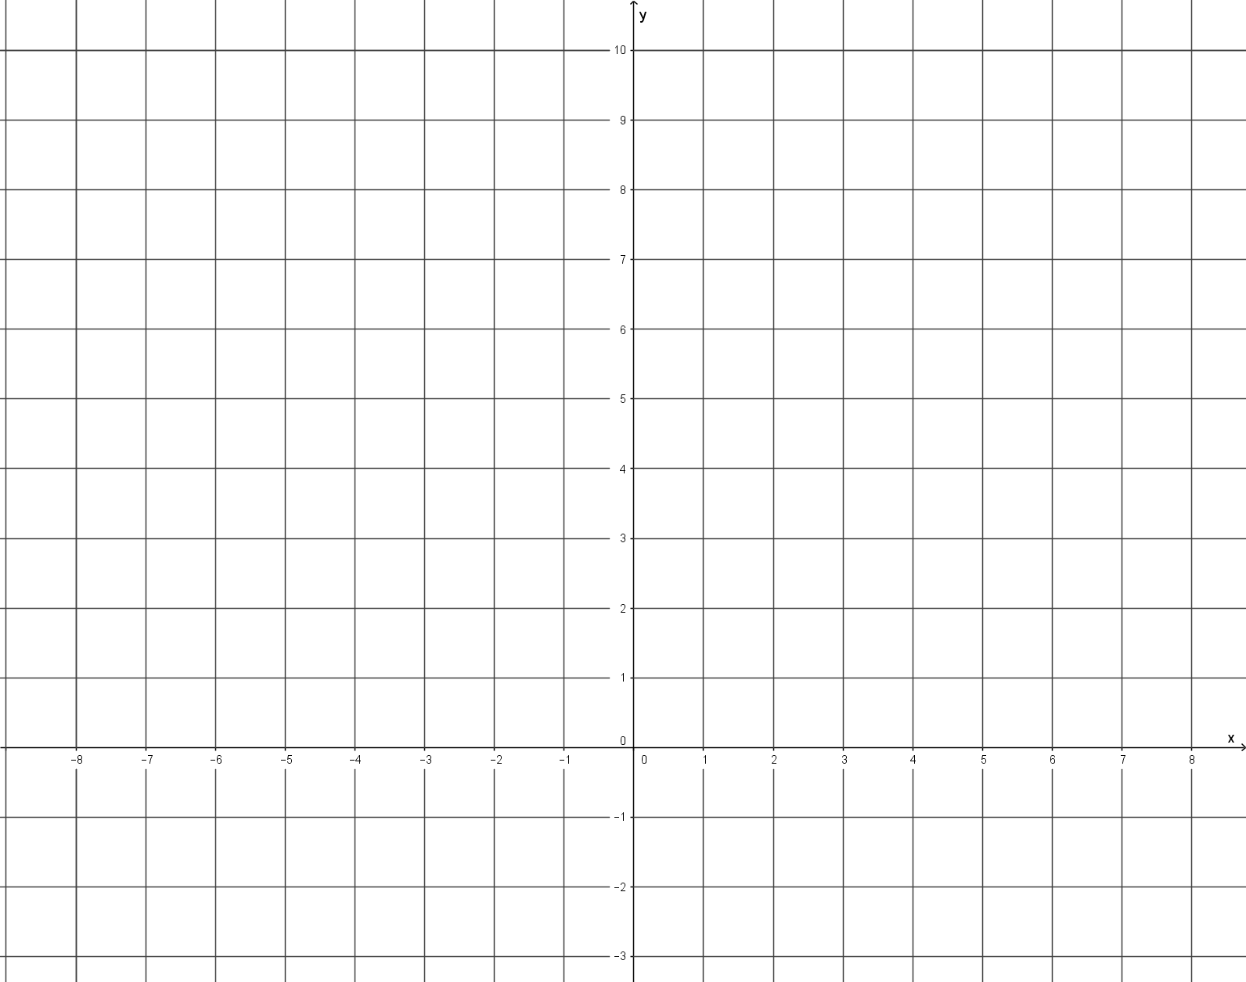
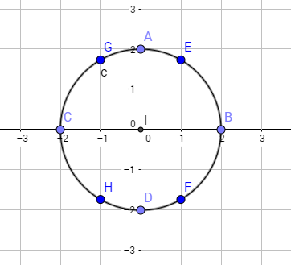

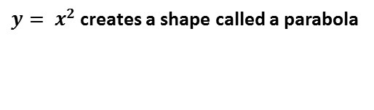

Finally …
$y= x^{2}$ creates a shape called a parabola
$$and$$
$x^{2}+y^{2}=4$creates a circle
y
10
9
8
7
6
5
4
3
2
1
0
1
2
3
-10 -9 -8 -6 -5 -4 -3 -2 -1 0 1 2 3 4 5 6 7 8 9
X

Slide 33
Now complete exercise 4.14 on page 63

